Slide 1
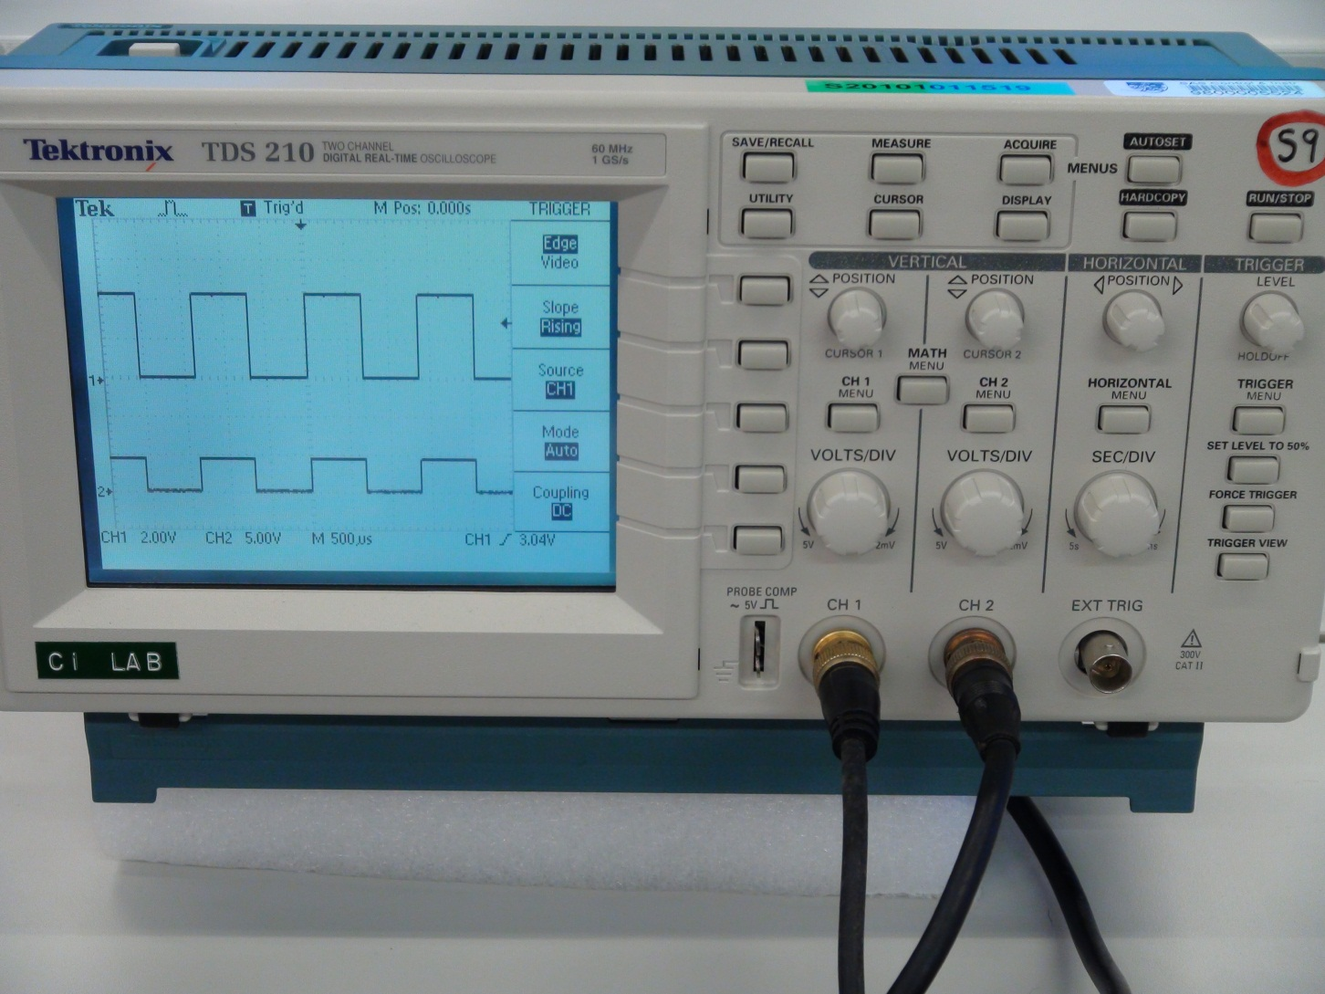
An overview of the Digital Oscilloscope
ON/OFF button

Slide 2
An overview of the Digital Oscilloscope
Display Area

Slide 3
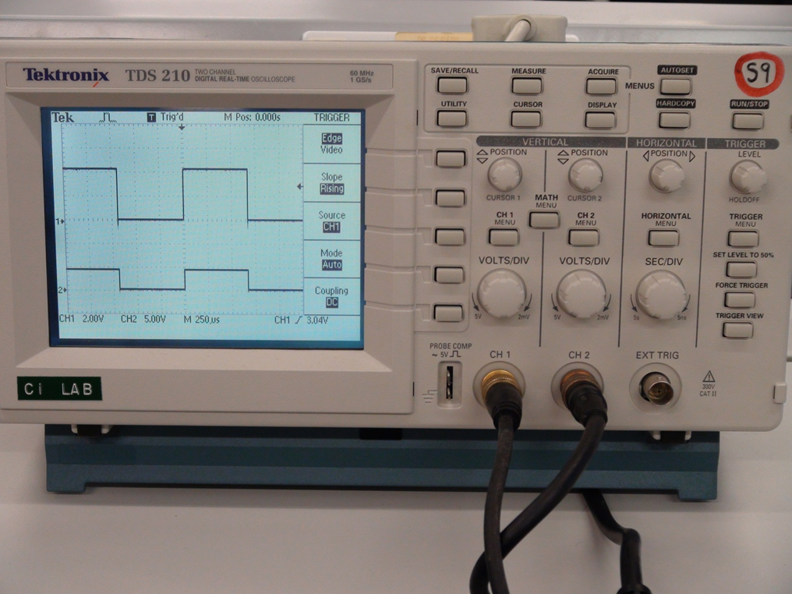
An overview of the Digital Oscilloscope
Control Panel

Slide 4
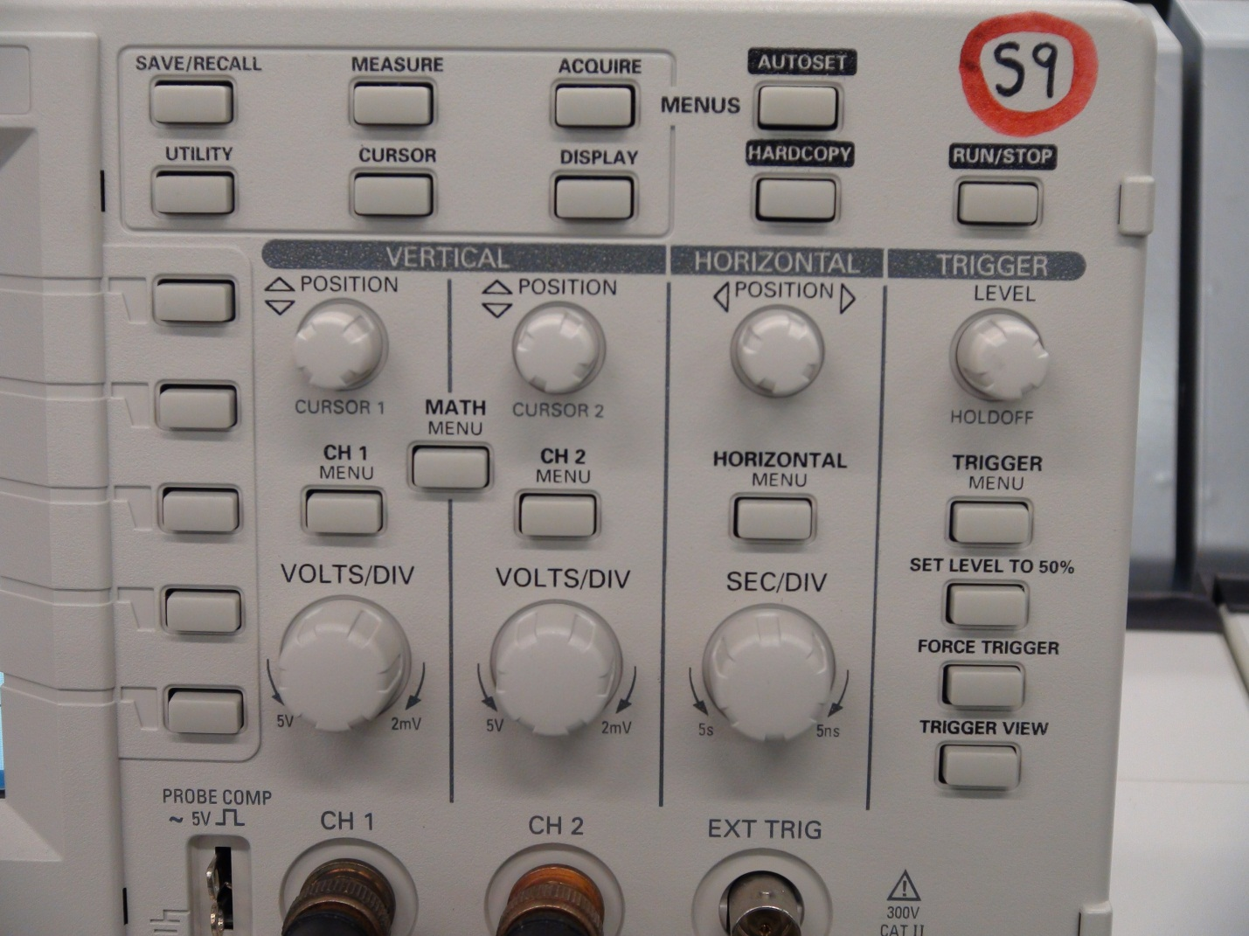
An overview of the Digital Oscilloscope
Vertical Controls

Slide 5
An overview of the Digital Oscilloscope
Horizontal Controls

Slide 6
AUTOSET button
AUTOSET button : Automatically sets the instrument controls to produce a usable display of the input signal.

Slide 7
Position Knobs
Cursor1 Position Knob : to position the waveform1 vertically

Slide 8
Position Knobs
Cursor2 Position Knob : to position the waveform2 vertically

Slide 9
VOLTS/DIV Knobs
CH1
CH2
Volts/DIV Knob :
to select the calibrated scale factor
CH1 is set to 2V/DIV
CH2 is set to 5V/DIV

Slide 10
SEC/DIV Knob
SEC/DIV Knob : to select the horizontal time/div
The time/div is set at 250us/div

Slide 11
POSITION Knob
POSITION Knob : Adjusts all the channels in horizontal position

